Slide 1
Monitoring at RNP 2002-2013
José Augusto Suruagy Monteiro
suruagy@CESAR.school

Slide 3
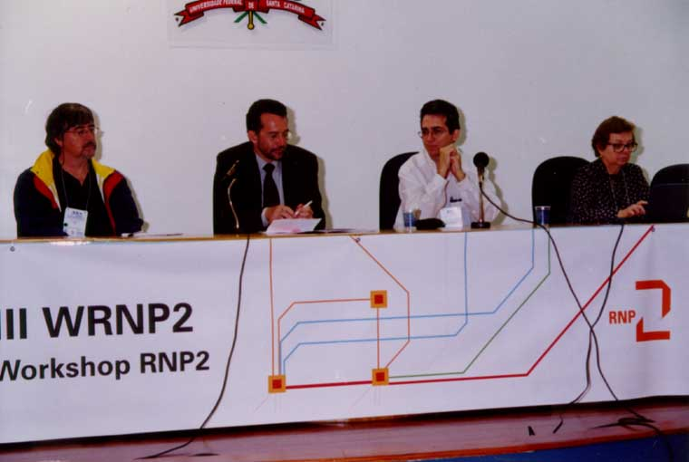
III WRNP2 – Florianópolis – May 21-22, 2001
https://memoria.rnp.br/wrnp2/2001/index.html
Context:
2000: RNP signed a MOU with Internet2
ReMAVs: High-speed Metropolitan Networks
Goals:
Promote synergy among researchers and technicians
Define research strategies
Tracks:
Network Enginnering
Applications
Middleware

Slide 4
Chronology
2002 – 2003: GT-QoS – QoS WG [UNIFACS, UFSC]
2003 – 2004: GT-QoS2 – QoS 2 WG [UNIFACS, UFSC]
2002 - 2004: IQoM – QoS Measurement Infrastructure and Differentiated Services Deployment [UNIFACS, UFPR, UFSC, UFRGS, CPqD, UL]
2004 – 2005: GT-Med – Measurements WG
2005 – 2007: GT-Medições 2 – Measurements 2 WG
2005 - 2008: GigaIQoM – A Measurement Infrastructure for the GIGA Network
[UNIFACS, UFF, UFSC, UFRGS, FURG, CPqD]
2007 – PerfSONAR Development Meeting in Salvador (May 1-4)
2008 - 2011: MonIPÊ - Serviço Experimental de Monitoração da Rede Ipê
2009 - 2010: MonEELA2 - EELA-2 Network Monitoring
2009 - 2010: MonCircuitos – Circuits Monitoring and Traffic Engineering
2011 - 2013: GT-Mediciones - Measurements at Red Clara

Slide 5
Chronology
2002 – 2003: GT-QoS – QoS WG [UNIFACS, UFSC]
2003 – 2004: GT-QoS2 – QoS 2 WG [UNIFACS, UFSC]
2002 - 2004: IQoM – QoS Measurement Infrastructure and Differentiated Services Deployment [UNIFACS, UFPR, UFSC, UFRGS, CPqD, UL]
2004 – 2005: GT-Med – Measurements WG
2005 – 2007: GT-Medições 2 – Measurements 2 WG
2005 - 2008: GigaIQoM – A Measurement Infrastructure for the GIGA Network
[UNIFACS, UFF, UFSC, UFRGS, FURG, CPqD]
2007 – PerfSONAR Development Meeting in Salvador (May 1-4)
2008 - 2011: MonIPÊ - Serviço Experimental de Monitoração da Rede Ipê
2009 - 2010: MonEELA2 - EELA-2 Network Monitoring
2009 - 2010: MonCircuitos – Circuits Monitoring and Traffic Engineering
2011 - 2013: GT-Mediciones - Measurements at Red Clara

Slide 6
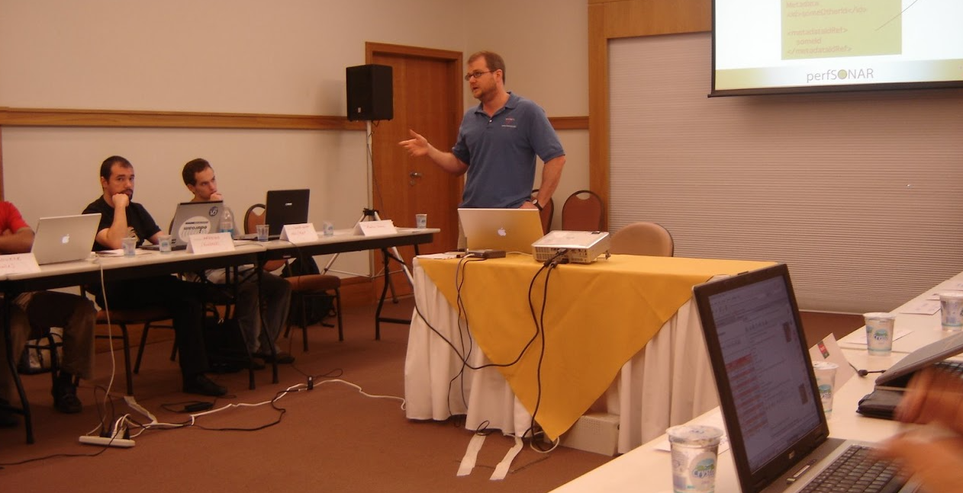
perfSONAR Development Meeting
Salvador, May 1-4, 2007
Notes:
Martin Swany

Slide 7
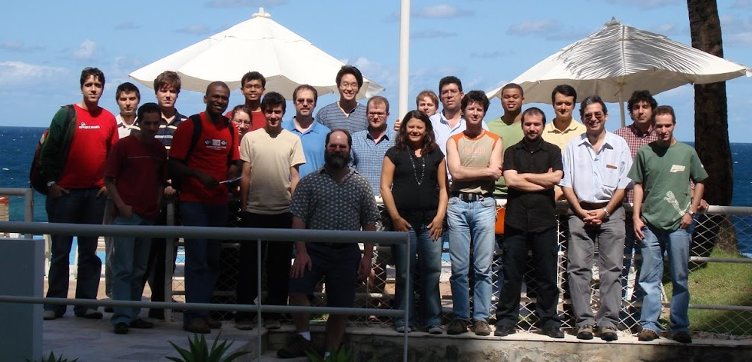
perfSONAR Development Meeting
Salvador, May 1-4, 2007

Slide 16
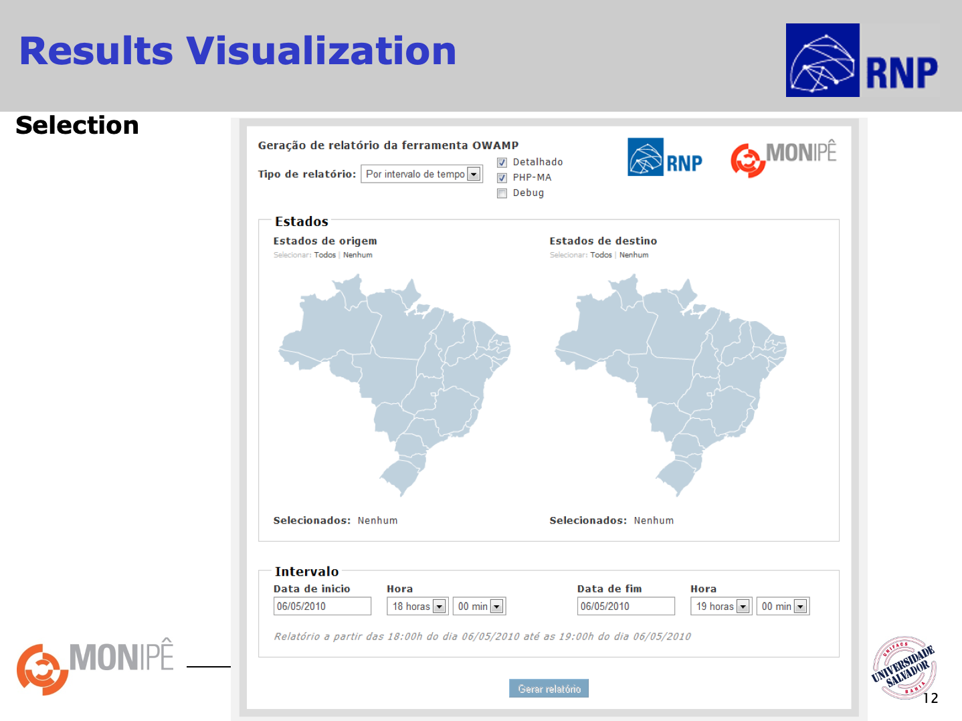

Slide 23
CT-Mon: Network Monitoring Technical Committee 2011-2013
Goals
Follow the development of perfSONAR to support RNP in the technical evolution of the MonIPÊ service, collaborating with the international standardization effort and its development.
Included also:
perfSONAR dissemination
Prospecting new tools and services
Recommendations for the MonIPÊ evolution:
Hardware update
Global scale monitoring
Dissemination to state, metropolitan and user institutional networks.

Slide 24
THANKS!
suruagy@CESAR.school

