Slide 1
Monitoring at PoP-SC / RNP 2012-2020+
Guilherme Eliseu Rhoden
guilherme.rhoden {at} rnp.br

Slide 2
PoP-SC | Roteiro (suprimir)
Participações do PoP-SC no perfSONAR
Timeline (resumida) 2DO
Monipê 1.0
Monipê 2.0
Medições e iniciativas
Homologador circuitos
Notes:
POP-SC / HISTÓRICO ATÉ 2013
Histórico
2002 - 2004 - IQoM - Infraestrutura para Medição de QoS e Implantação de Serviços Diferenciados (CNPq/RNP)
2002 - 2003 - GT-QoS - Grupo de Trabalho de Qualidade de Serviço da RNP
2003 - 2004 - GT-QoS2: GT Qualidade de Serviço 2
2004 - 2005 - GT-Med - Grupo de Trabalho de Medições
2005 - 2007 - GT Medições 2
2005 - 2008 - GigaIQoM - Uma Infraestrutura de Medições para a Rede Giga
2008 - 2011 - MonIPÊ - Serviço Experimental de Monitoração da Rede IPÊ
2009 - 2010 - MonCircuitos - Monitoração de Circuitos e Engenharia de Tráfego
2009 - 2010 - MonEELA2 - EELA-2 Network Monitoring
2012 – MonIPÊ – Serviço
2013 – MonIPÊ – Serviço em produção

Slide 3
MonIPE releases
2008-2012: MonIPE 1.0 released
2013-2016: MonIPE 2.0 released
2016: Circuit Validation Service released

Slide 4
2008-2012: MonIPE 1.0 ​

Slide 5
GPS Sync kit
2008-2012:
MonIPE 1.0
MP
1 2
3
Passive measurements (flows)

Slide 6
Low cost kits (generation 1 and 2) | 2015
2013-2016: MonIPE 2.0
Metrics
1)
RTT
Delay / Loss / Jitter
One Way
Delay / Loss / Jitter
Traceroute
2)
Achievable bandwidth
Clients
400Mb/s
1
G1
2
1
1Gb/s
1
G2
2
2
PoPs
10Gb/s
Achievable bandwidth (10Gb/s)
1
2

Slide 7
MonIPE: Logical architecture in domains
2013-2016: MonIPE 2.0 released

Slide 8
WEB Interface
2013-2016: MonIPE 2.0
2014 | MonIPÊ live
Distribution of more than 200 units in WRNP
Bootable measurement point

Slide 9
MEASUREMENT MATRIX | RNP BB :: 2025
https://l1nq.com/s75bP | RNP Madash perfSONAR

Slide 10
Contributions from perfSONAR to PoP-SC
Expanded measurement culture
It has been used for a long time to obtain quality metrics
One way loss/delay between PoPs
It has been deployed on PoP/REMEP/WAN clients
Development of circuit homologation software

Slide 11
circuit validation: manual process on PoP-SC (the beginning)
Objective: Verify circuit compliance with contract specifications
Process - AS-IS: for new circuit 2012/2013
Manual and slow process
Approved in the first round
8 steps – 64h / 2.6 days
Approved in the the second round
5 steps – 61.5h / 2.5 days
Lots of rework and wait time

Slide 12
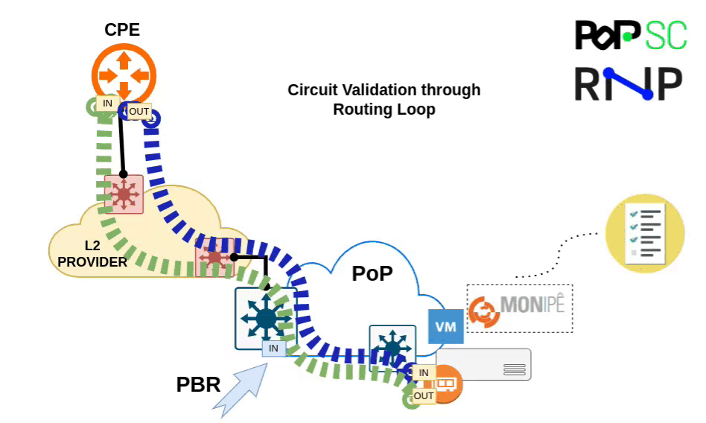
MonIPE | Circuit validation

Slide 13
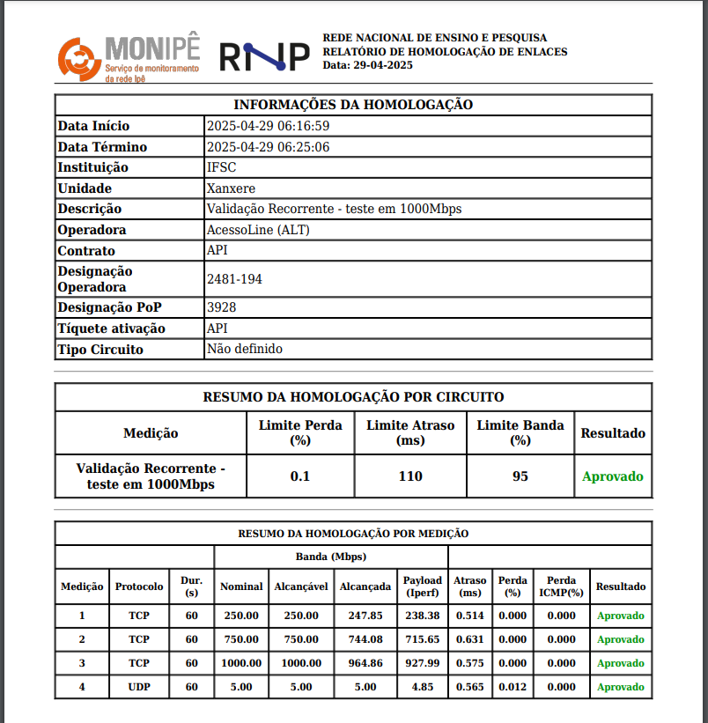
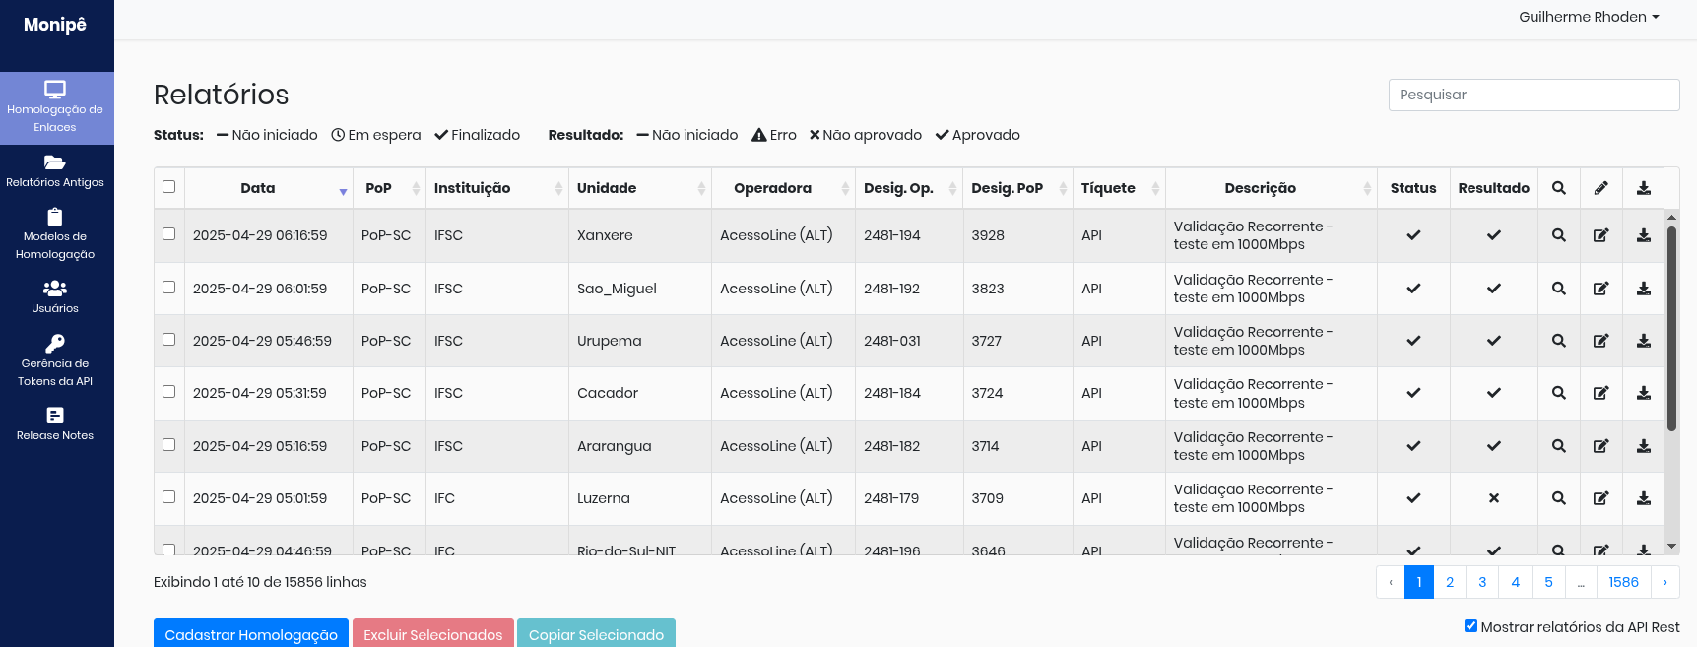
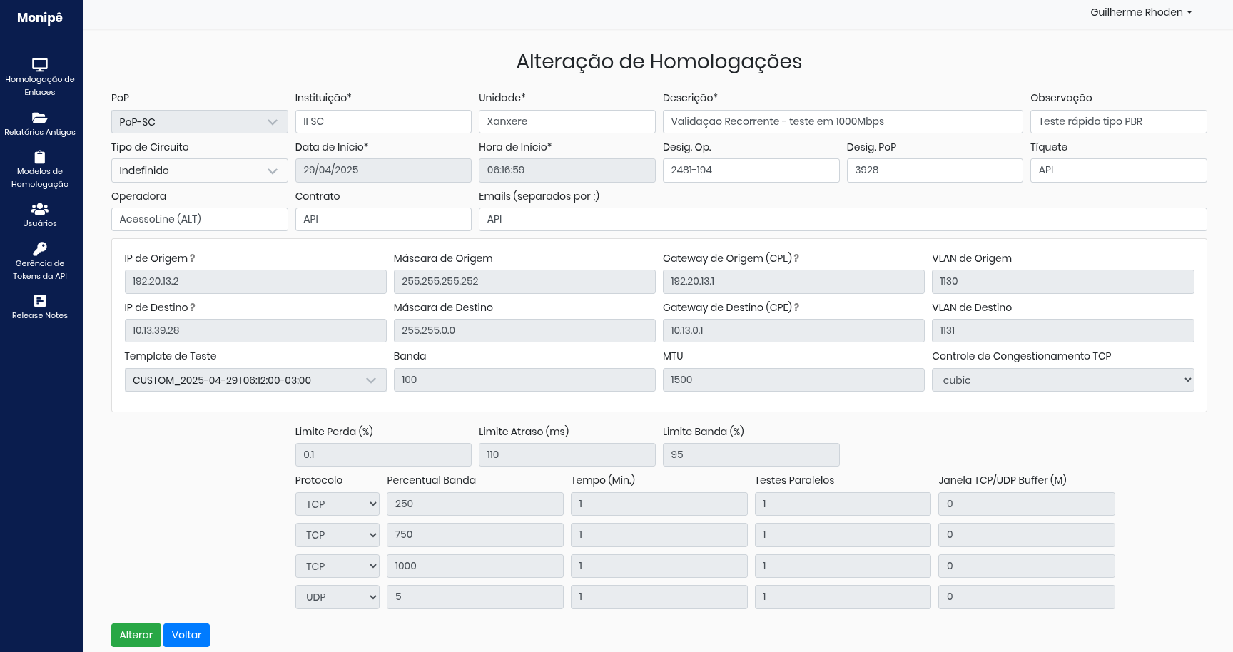
MonIPE | Circuit validation
Circuit validation Tool
Web interface and PDF result report

Slide 14
circuit validation with monIPE
2016 ~ 2025
70% more efficient
Approved in the first round
4 steps – 18h / 0.7 days
Approved in the the second round
3 steps – 58h / 2.4 days

Slide 15
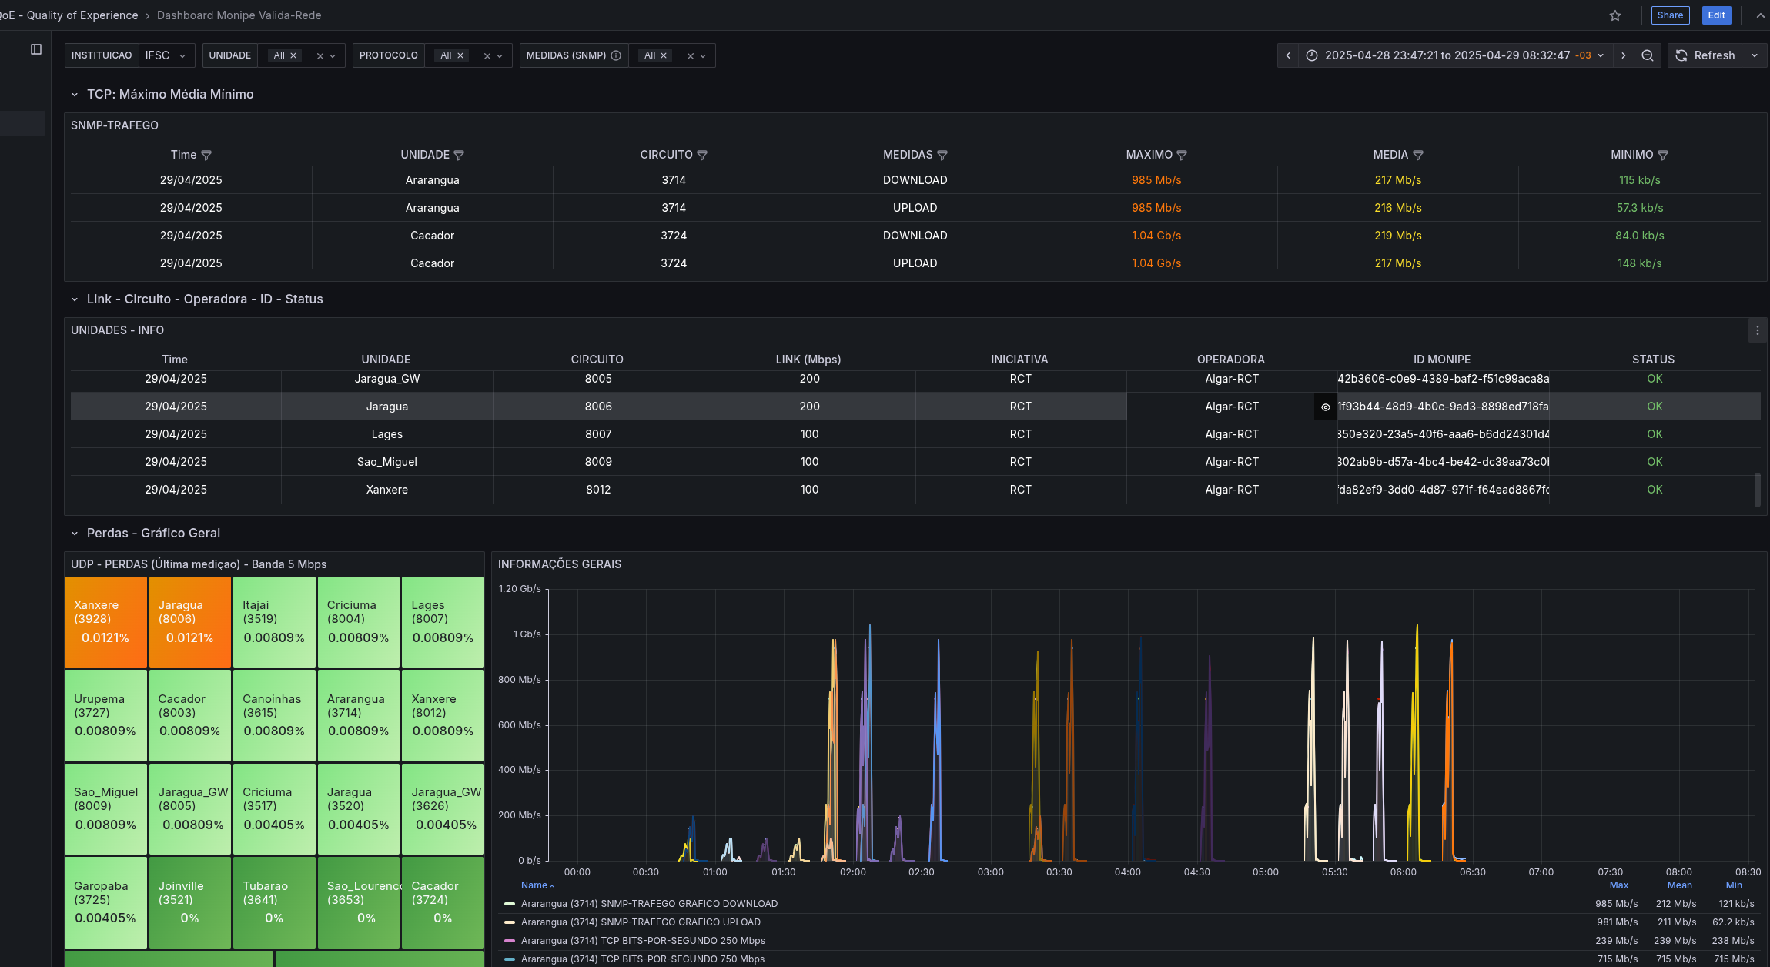
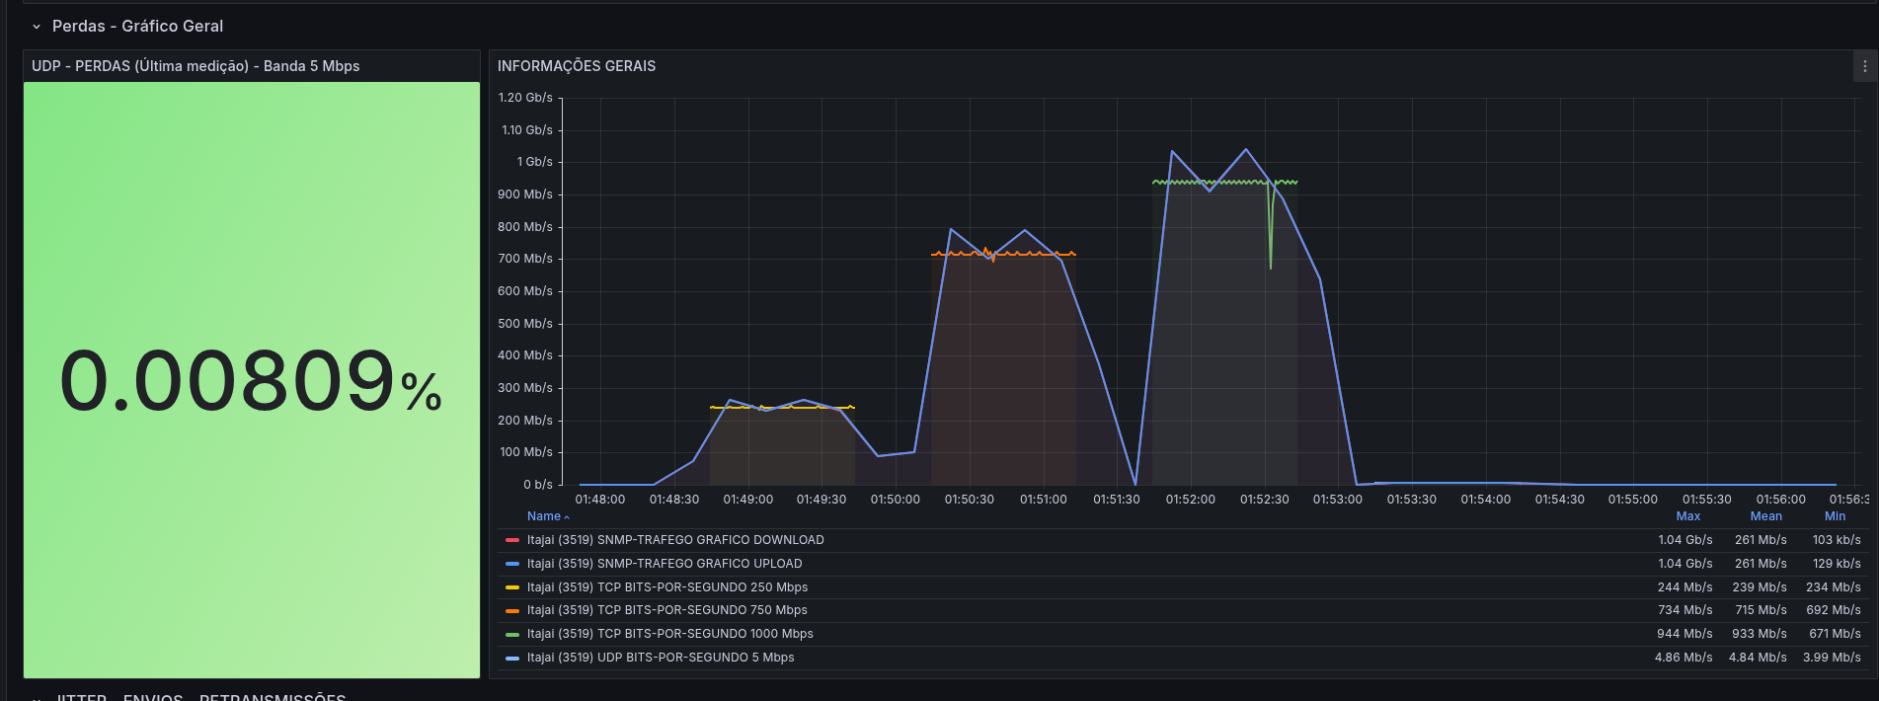
PoP-SC | ValidaREDE | recurring circuit validation
2024/2025
(via monIPE API )​
ValidaREDE automates periodic circuit measurements by integrating the MonIPÊ API and router traffic data obtained via SNMP, and provides visualization through InfluxDB and Grafana.

Slide 16
Thanks to those involved in PoP-SC (2005 – 2025)
GTs + perfSONAR + Medições
Edison Melo
Murilo Vetter
Guilherme Rhoden
Paulo Brandtner
Luis Cordeiro
Rodrigo Pescador
Fausto Vetter
Bruno Petroski
Roberto Neto
Mateus Goulart
Caetano Torres
Marco Curi
Jonatan Matschulat
André Durieux
Leonadro Leite
Kádio Colzani
Augusto Carlson

Slide 17
Thanks!
guilherme.rhoden {at} rnp.br

