Slide 1
SFC Placement in Edge-Cloud Environments: a Distributed Approach
Estudante de doutorado:
Anselmo Luiz Éden Battisti
Universidade: UFF
Orientador: Paulo de Figueiredo Pires
Data Apresentação: 04/03/2023
Notes:
Olá meu nome é Anselmo, essa é a apresentação da minha defesa de mestrado, cujo título do trabalho é .....
Minhas orientadoras são a professora Débora e professora Flávia

Slide 2
Agenda
Introduction
NFV Paradigm
SFC Definition
Distributed Environment
SFC Placement Problem
Centralized
Distributed
Next Steps

Slide 3
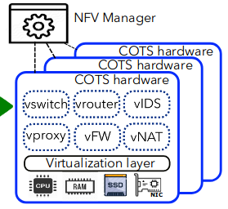
Introduction
In the last decades, there has been a trend to virtualize computing and networking resources.
This trend reaches the core functions of the networks, creating the NFV paradigm.
Nowadays, high-level functions consumed by the users like, video encoders are also virtualized.
T. Zhang, H. Qiu, L. Linguaglossa, W. Cerroni and P. Giaccone, "NFV Platforms: Taxonomy, Design Choices and Future Challenges," in IEEE Transactions on Network and Service Management, vol. 18, no. 1, pp. 30-48, March 2021, doi: 10.1109/TNSM.2020.3045381.

Slide 4
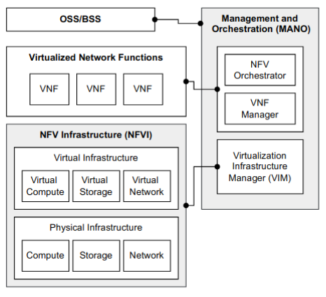
Introduction
For decoupling the VNF from the hardware, the NFV Platform provides virtualization through the NFVI component.
Popular hypervisors, such as XEN4, Kernel-based Virtual Machine (KVM), and VMware, are used to virtualize resources consumed by VNFs.

Slide 5
Introduction
The VIM component provides the interfaces that enable the MANO component to request and monitor the VNF resources accordingly.

Slide 6
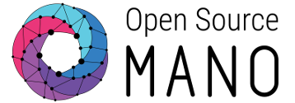
Introduction
Examples of NFV platforms

Slide 7
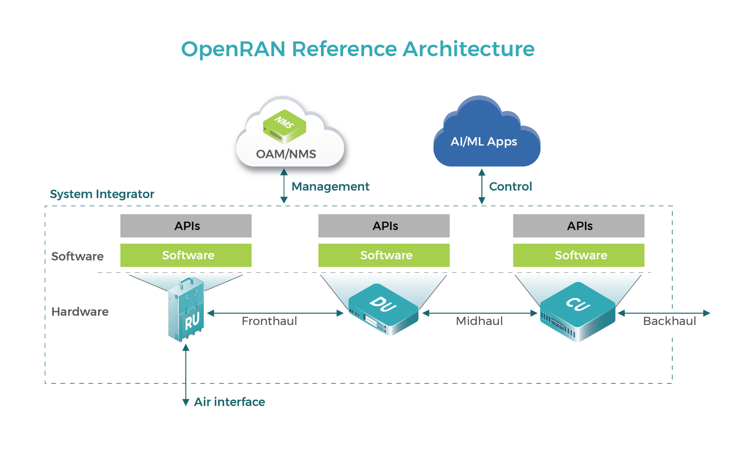
Introduction
OpenRAN

Slide 8
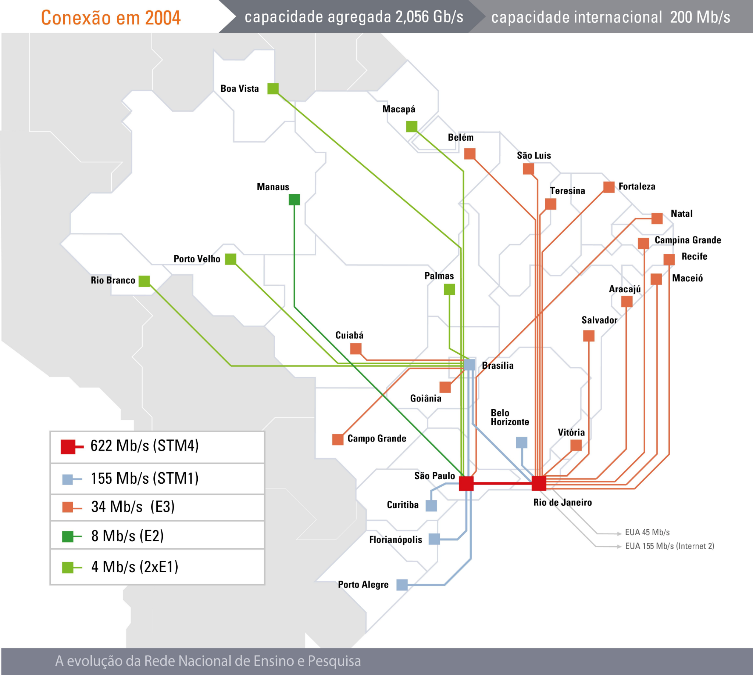
VNF Placement Problem
With the adoption of the NFV paradigm, a new problem named VNF Placement Problem emerged.
The VNF Placement decides which computational node will be used to execute the Virtual Network Function (VNF).
Rede Ipê
https://www.rnp.br/sobre/nossa-historia/evolucao-da-rede-ipe

Slide 9
VNF Placement Problem
This problem was already proved as being an NP-Hard problem
https://ieeexplore.ieee.org/document/7524565
Thus, creating good heuristics is fundamental to addressing this problem.
Rede Ipê
https://www.rnp.br/sobre/nossa-historia/evolucao-da-rede-ipe

Slide 10
SFC Definition
However, virtualizing VNFs individually is insufficient to meet the services requirements in traffic demands and complexity.
These aspects have created a new technology called SFC.
The SFC is a chain of multiple VNFs with an SLA associated.
Santos, GL, Endo, PT, Sadok, D, Kelner, J. SPIDER: An availability-aware framework for the service function chain placement in distributed scenarios. Softw Pract Exper. 2022; 1- 25. doi:10.1002/spe.31544

Slide 11
SFC Placement Problem
Now the SFC Placement Problem has emerged.
New challenges must be addressed beyond defining where to execute each VNF of the requested SFC, the networking connectivity must be created to enable the flow across all the VNFs.

Slide 12
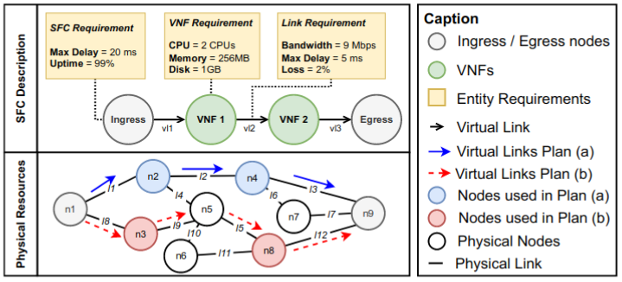
SFC Placement Problem

Slide 13
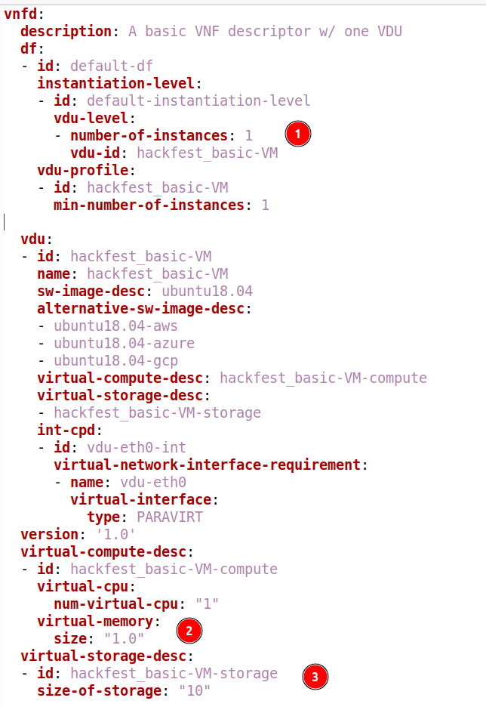
Static Approach Placement / Orchestration
The requirement aspects of the VNF/SFC are statically defined in a descriptor file.
The orchestrator component follow the specifications to orchestrate the life cycle of the VNF/SFC.

Slide 14
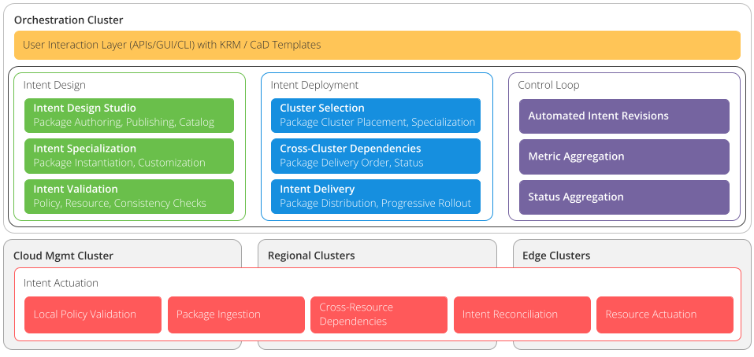
Dynamic Approach Placement / Orchestration
Definitions of the VNF/SFC are specified based on intentions.
The orchestrator component follow the specifications to orchestrate the life cycle of the VNF/SFC.

Slide 15
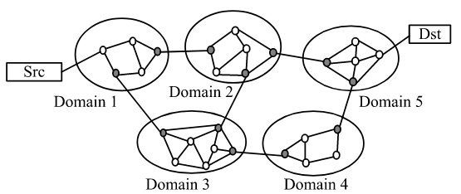
Distributed Environment
With the advance of the Edge-Cloud computing paradigm, the VNFs of the SFC can be executed in multiple nodes that can potentially be managed by different service providers.
G. Sun, Y. Li, D. Liao and V. Chang, "Service Function Chain Orchestration Across Multiple Domains: A Full Mesh Aggregation Approach," in IEEE Transactions on Network and Service Management, vol. 15, no. 3, pp. 1175-1191, Sept. 2018, doi: 10.1109/TNSM.2018.2861717.

Slide 16
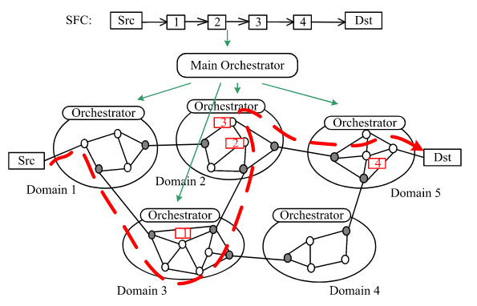
Distributed Environment
In this scenario, a centralized placement is unsuitable, given the huge number of nodes and the confidentiality problems.
Thus, a distributed mechanism should be created to allocate the SFC without full knowledge of the infrastructure where the VNFs will be executed.
G. Sun, Y. Li, D. Liao and V. Chang, "Service Function Chain Orchestration Across Multiple Domains: A Full Mesh Aggregation Approach," in IEEE Transactions on Network and Service Management, vol. 15, no. 3, pp. 1175-1191, Sept. 2018, doi: 10.1109/TNSM.2018.2861717.

Slide 17
Next Steps
Study the nephio framework
Extend the nephio framework to execute our distributed SFC placement approach it in a multi-domain environment.

Slide 18
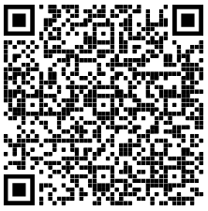
Contatos
Anselmo Luiz Éden Battisti
anselmo@midiacom.uff.br
Paulo de Figueiredo Pires
paulo.pires@ic.uff.br

